Slide 1
SoundPrints
Lo-Fi Prototyping
Niki A, Safiyah L, Roy Y, Raymond G
Notes:
Hi everyone, today I’ll be discussing the SoundPrints team’s low-fidelity prototyping process.

Slide 2
Overview
Mission Statement and Value Proposition
Selecting Map-Based Mobile App Interface
Lo-Fi Prototype
Prototype Testing and Analysis
Notes:
Guided by our mission statement and value proposition, we began by exploring several design ideas, and ultimately selected a map-based mobile app as our interface design. We then created a low-fidelity prototype based on this design. We analyzed the results of our prototype test to identify areas where we can improve. I’ll be walking you through each of these core steps.

Slide 3
Mission Statement & Value Proposition
Our Mission: Enable people to connect with and inspire one another through collective, location-based audio journaling.
Value Proposition: Audio spaces that connect and inspire.
Notes:
SoundPrints mission is to enable people to connect with and inspire one another through collective, location-based audio journaling. More simply, our value proposition is: Audio spaces that connect and inspire.

Slide 4
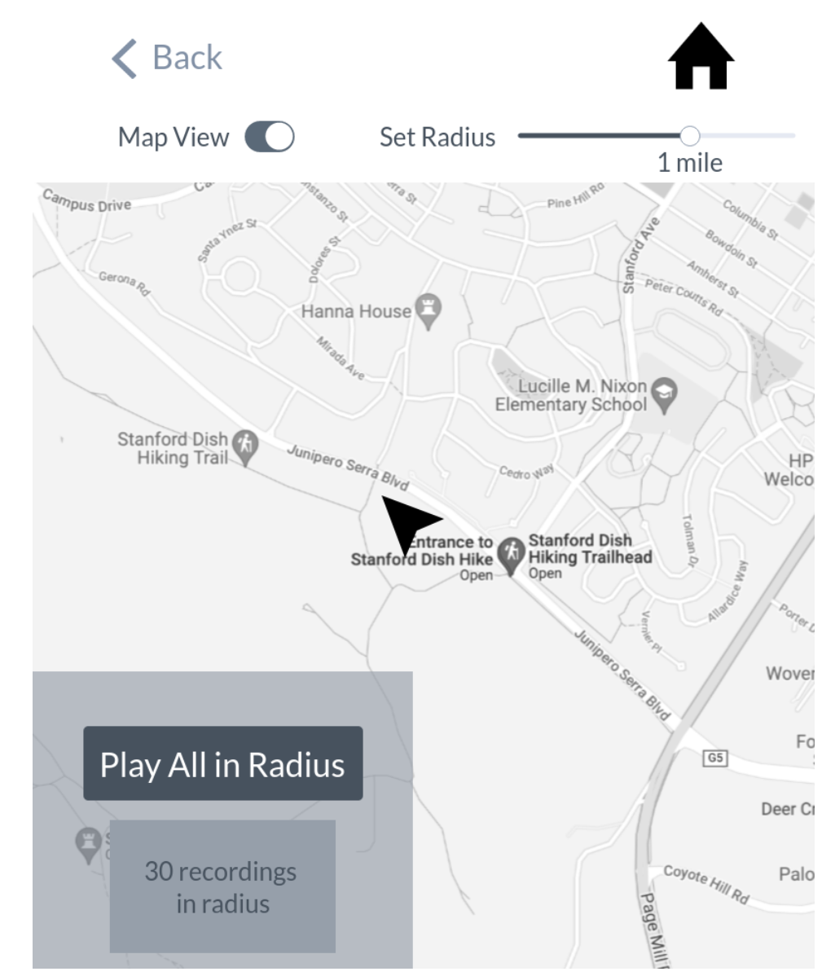
Selected Interface: Map-Based Mobile App
Map integrated into mobile app
Centered around user’s location
Visual: Clear relationship between recordings and location.
Ease of Use: Can just plug in headphones and listen
  AR/VR solutions are cumbersome
Data: Can broaden the “radius” of the map if recordings near you are sparse.
Notes:
After exploring interface designs ranging from Augmented Reality to wearable technology, we decided to proceed with a map-based mobile application. By map-based, we mean that a map is integrated into the app, and you can see your location in the map while using it. There are three main benefits of this interface design. One, it is highly visual, with a very clear relationship between recordings and the location they were made in. This emphasizes to the user that they are listening to recordings made near their location. Second, this interface is easier to use compared to an augmented or virtual reality solutions. We want users to be able to plug in their headphones and just listen to recordings, without worrying about holding up their phones for AR or wearing VR glasses. Finally, if this app were to launch, initially there wouldn’t be too many users. This design helps us account for that issue, because we have a feature that enables users to adjust the radius of the map to include more or less recordings that they can listen to.

Slide 5
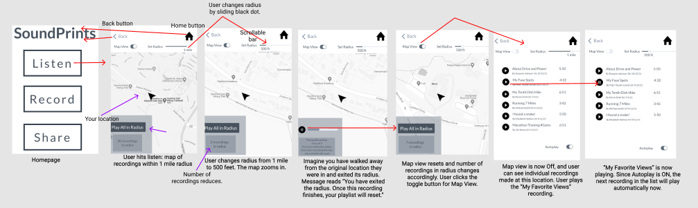
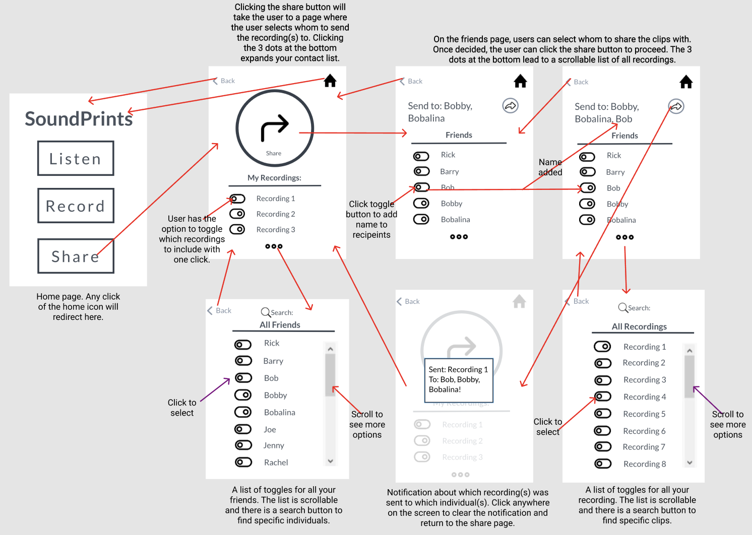
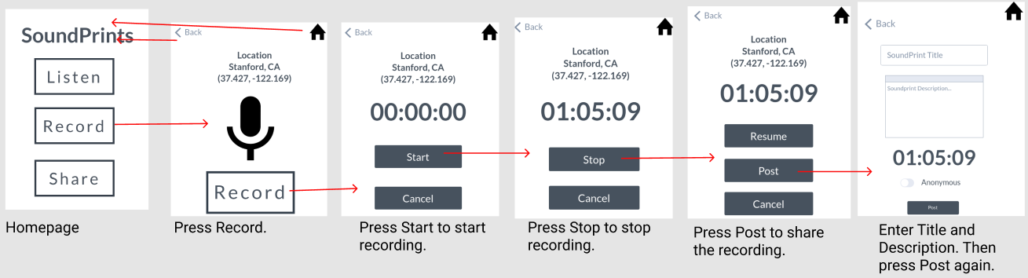
Lo-fi Prototype Structure
SHARE
LISTEN
RECORD
Notes:
Our low fidelity prototype begins with a homepage, with three key functions, Listen, Record, and Share. These each branch off into their own flow of frames. Our prototypes are black and white, and we made them in the Marvel POP tool.

Slide 6
Simple: Listen to recordings made by others near your location.
Sub-task: Listen to recordings made within 500 feet of your current location until the playlist resets.
Sub-task: Listen to the recording “My Fave Spots.”
Notes:
Our simple task is…
For the purpose of our prototype testing, we decided to break this up into two specific subtasks, in order to effectively test all the features that we wanted to test.

Slide 7
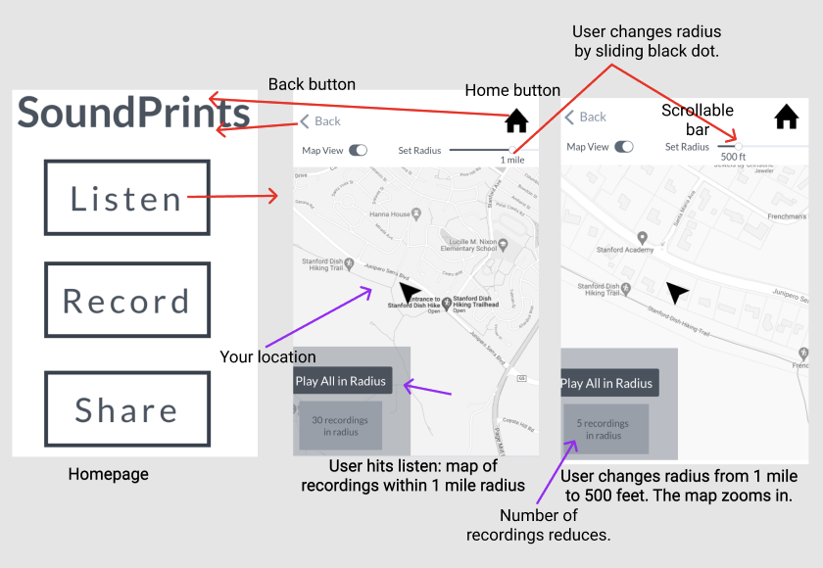
Listen to recordings made within 500 feet of your current location until your playlist resets.
Notes:
ALTERNATE

Slide 8
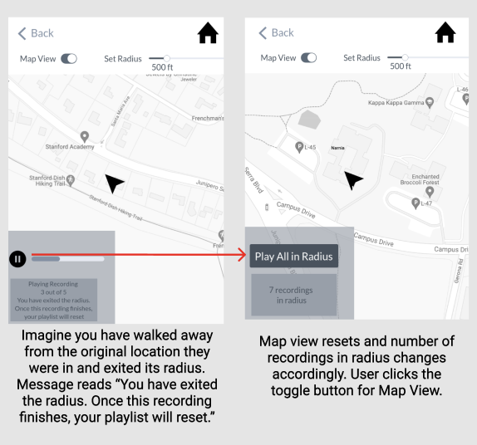
Listen to recordings made within 500 feet of your current location until the playlist resets.
Notes:
ALTERNATE

Slide 9
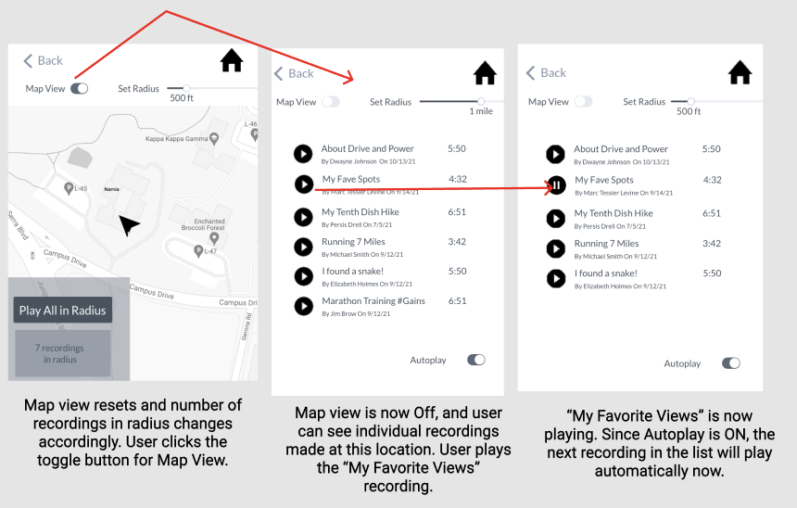
Listen to the recording “My Fave Spots.”
Notes:
ALTERNATE

Slide 10
Moderate: Add your own recording to the set of recordings made near your location.
Notes:
3 tasks & task flows shown carrying out each task w/ low-fi (1 slide per task)

Slide 11
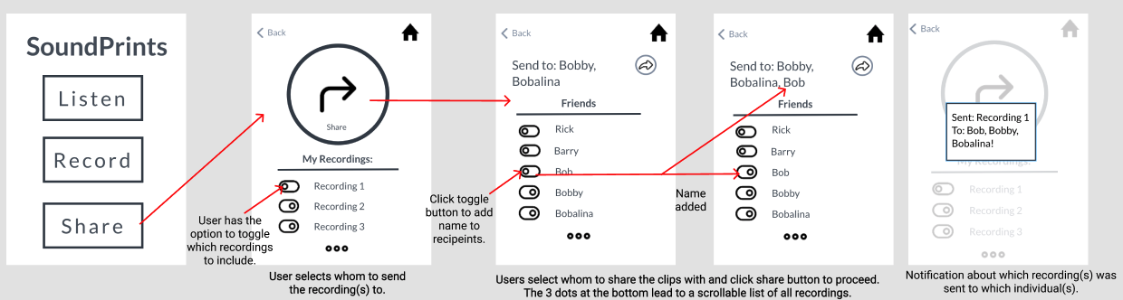
Complex: Share a recording that you made with at least 2 friends.
Notes:
3 tasks & task flows shown carrying out each task w/ low-fi (1 slide per task)

Slide 12
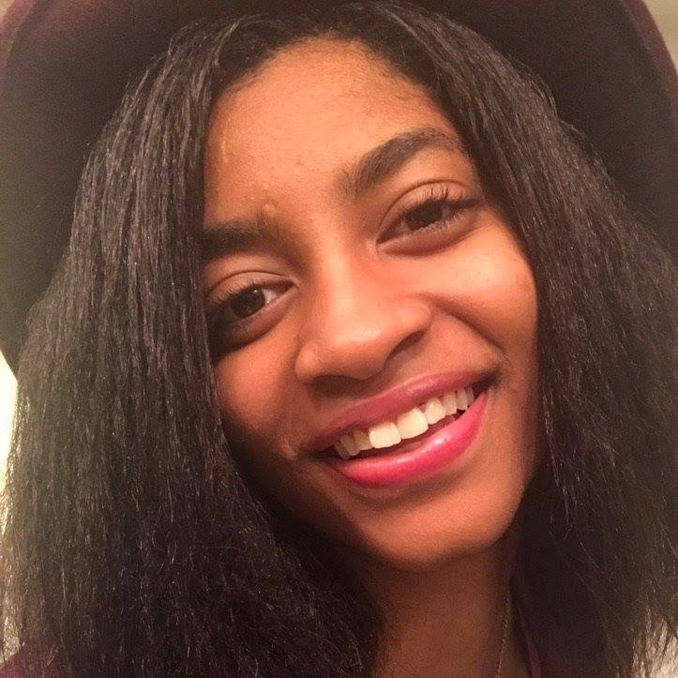

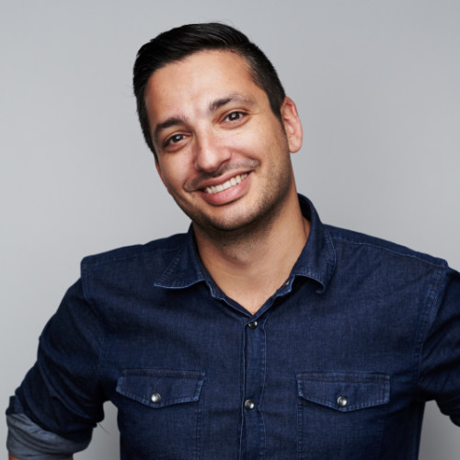
Experiment Participants
Nicel
University of Washington PhD student
Struggles to exercise without company of others
Enjoys podcasts
Hafsah
Senior PM
Lives in Madison, Wisconsin
Likes to explore new places and try new things
Joel
Head of Data
20 years in tech industry
Enjoys listening to podcasts while running
All interviews conducted via Zoom using Marvel POP by sharing mobile phone screen
All participants recruited via mutual friends

Slide 13
Experimental Method
Set the scene: Imagine you’re at the Stanford Dish Hiking Trail.
Rotated roles: Greeter, Facilitator, 2 Observers
Usability Goals:
Robust: How frequently do they go down the wrong path?
Pleasant: What do they like? What do they find frustrating or confusing?
Follow up questions: How was your experience?

Slide 14
Users enjoy the Map View
“It really emphasizes that the recordings were made near me.”
“Adjusting the radius is a cool feature!”
“I like seeing where I am.”

Slide 15
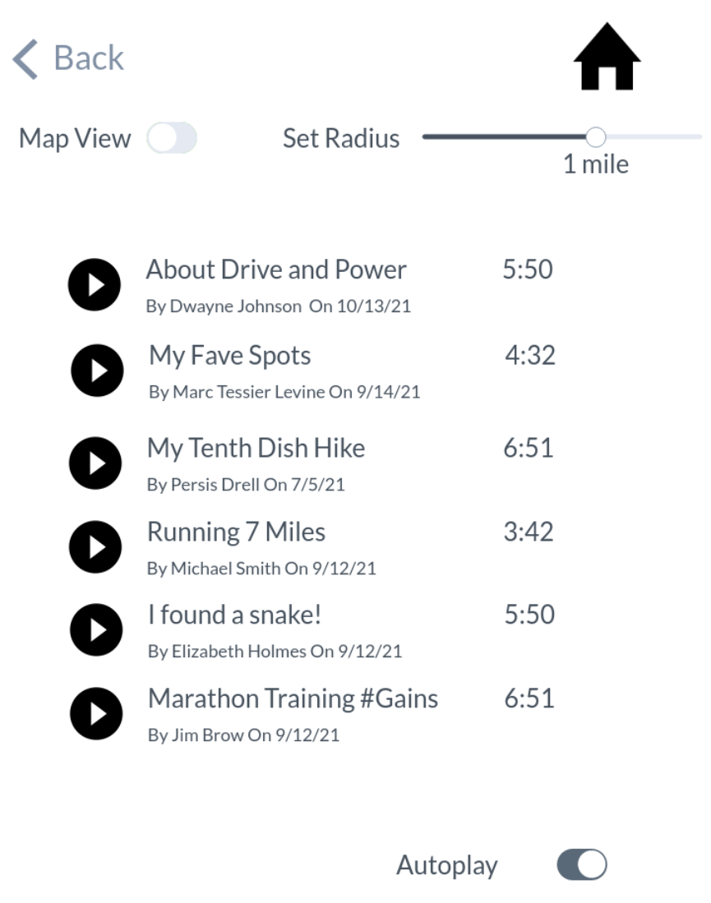
Users struggle to play individual recording of their choice
“Am I supposed to see the names of the recordings somewhere?”
“I didn’t understand what the Map On and Off view is for, so I didn’t try it.”

Slide 16
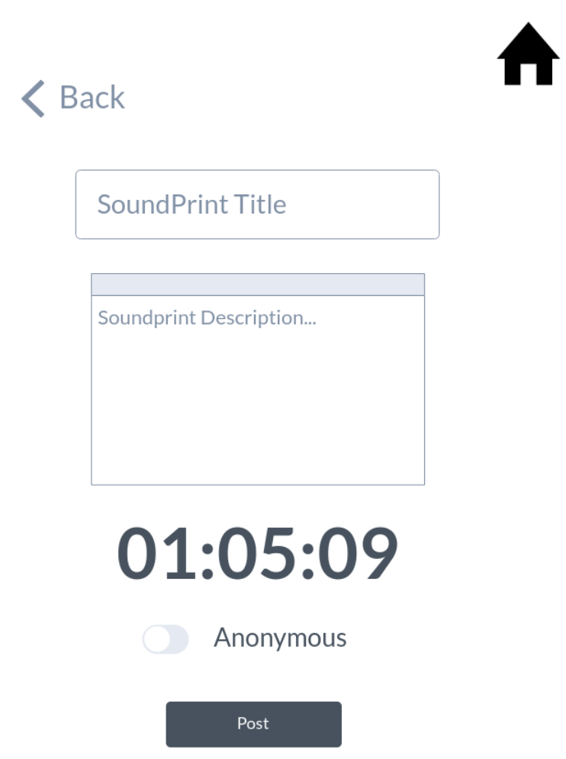
Users like naming recordings and playing them by name
“I like seeing the recordings by name. I can play the ones I’m more interested in.”
“Being able to name and describe my recordings enables me to track them better.”

Slide 17
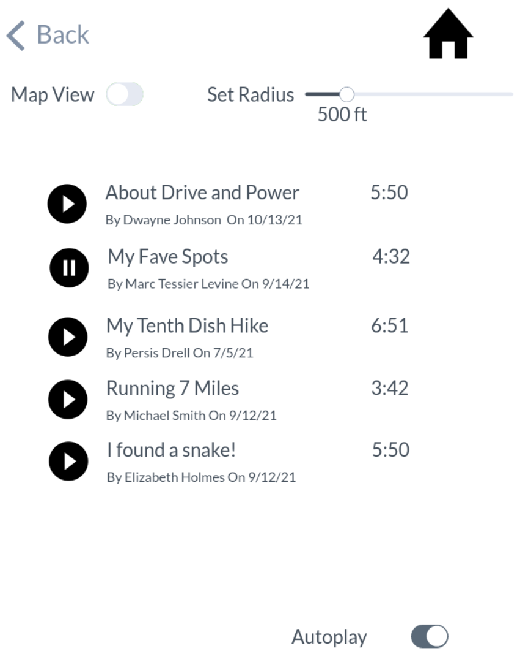
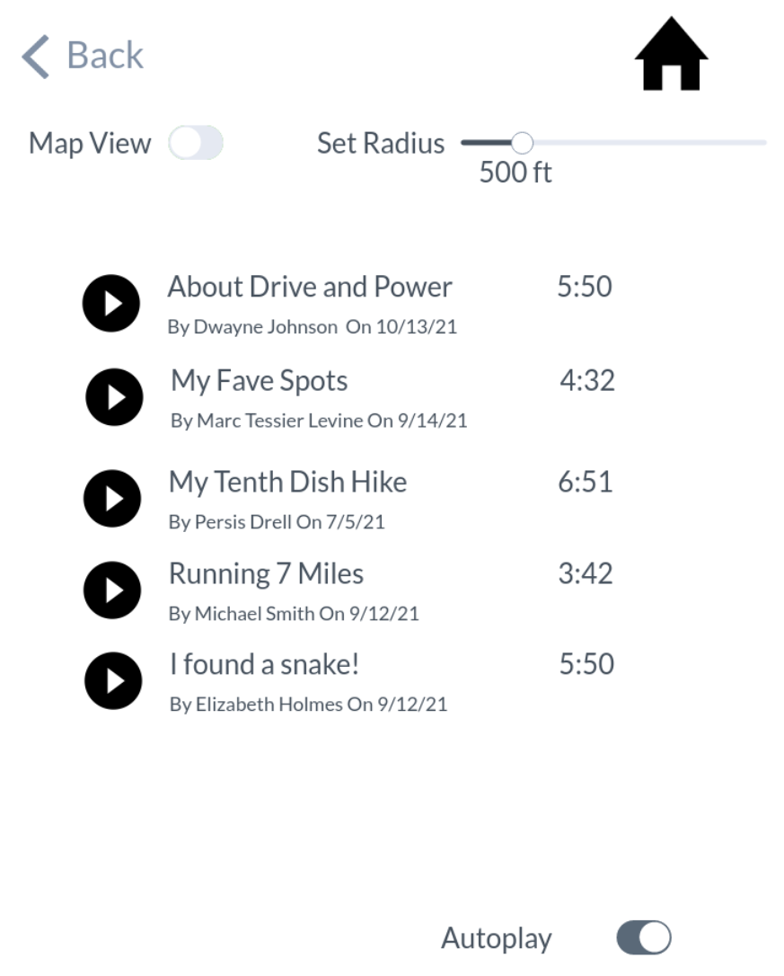
Users struggle to use some buttons
Have to go back to home page to do every task.
Confusion: Back button linking back to previously viewed screen
“The back button feels unnecessary when you have a home button.”

Slide 18
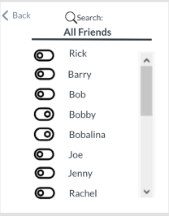
Users struggle to use some buttons
“Why do some of your toggle buttons look different than others?”
“Without colors, it’s hard to be sure how it works.”
Users liked this toggle!
Users did NOT like this toggle.

Slide 19
Overall Results
Listen task involves the most interesting features but biggest errors
Record and Share are more robust

Slide 20
Suggested UI Changes
Have a “View Recordings button” rather than Map View On/Off.
View Individual Recordings

Slide 21
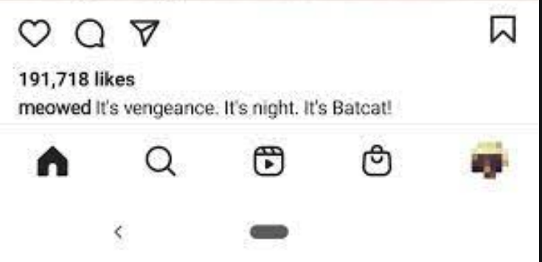
Suggested UI Changes
Remove back button.
Integrate important screens as a bottom navigation bar so that they can be quickly accessed from any other screen.
Consistent, clear interface for all toggles.
We envision our navigation bar to look similar to Instagram’s with icons for homepage, listen, record, and share.

Slide 22
Summary
Built and tested low-fidelity prototype based on map-based mobile app design
Conducted and analysis 3 Zoom prototype-testing interviews
Users enjoy overall design, particularly the map
We need to ensure clarity and simplicity of usage for all our features and buttons

Slide 23
Appendix

Slide 24
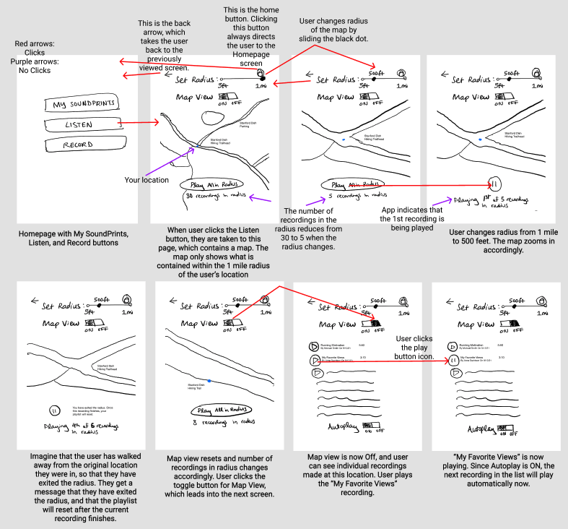
Notes:
^ UI Task Flow sketch for Listen task

Slide 25
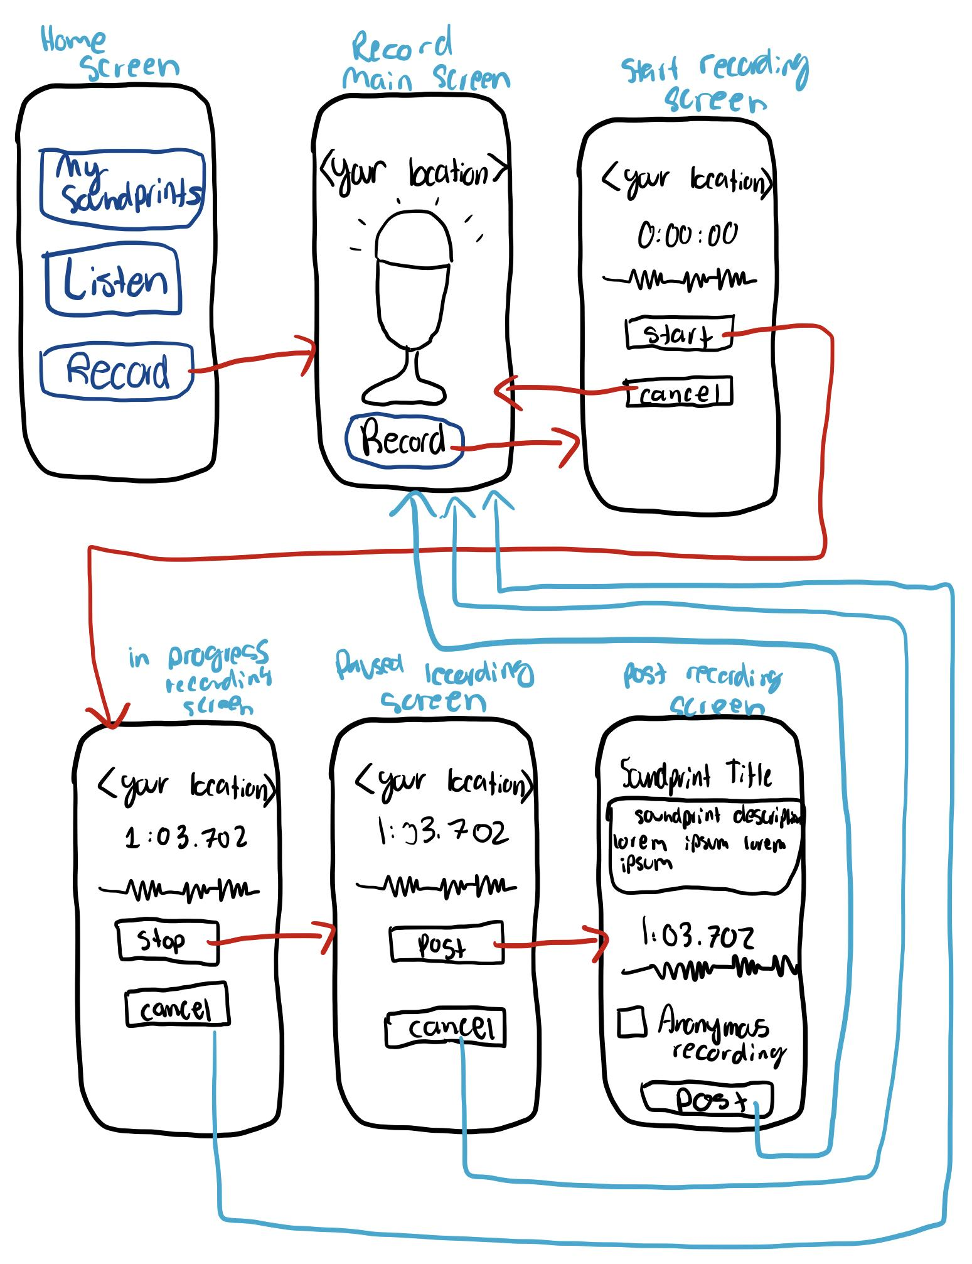
Notes:
^ UI Task flow sketch for record task

Slide 26
Notes:
Full task flow for share task

